Slide 1
Hampton City Schools
Principals’ Professional Development Meeting
October 6, 2016
Old Dominion University Peninsula Center
Dr. Jeffery O. Smith, Superintendent
Hampton City Schools

Slide 2
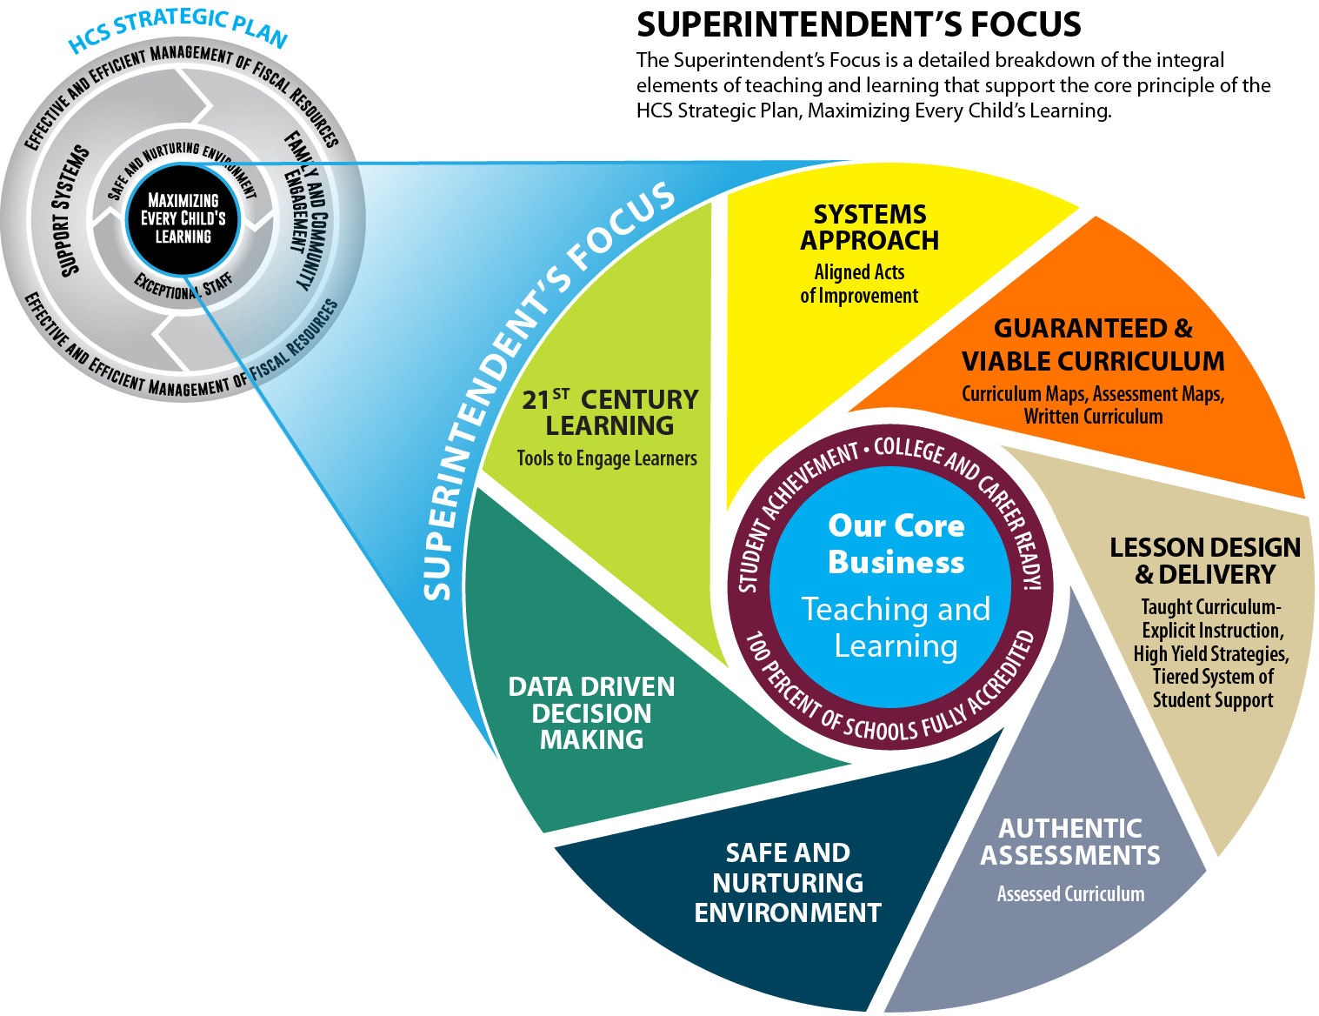

Slide 3
The Work Ahead

Slide 4
Expected Student Achievement Outcomes
All schools will be fully accredited.
95% of third graders will be reading on-grade level (as measured by the Scholastic Reading Inventory) by the end of the 2020 school year.

Slide 5
Expected Student Achievement Outcomes
By the year 2020, each middle school student will explore at least two career pathways prior to entering ninth grade.

Slide 6
Expected Student Achievement Outcomes
By the year 2020, each middle school student will be involved in at least one extracurricular activity with a mentorship component.

Slide 7
Expected Student Achievement Outcomes
95% of the 2017-2018 ninth grade cohort will graduate on time with a diploma and credentials that verify they are prepared to succeed in the economy and the community.

Slide 8
Expected Student Achievement Outcomes
The division's SAT or ACT composite score in reading and mathematics will be at the national average by 2020.
All schools will meet the division's established safe and nurturing learning environment criteria/goals.

Slide 9
Knowing and Owning Your Student Achievement Data

Slide 10
Accreditation Action Plans - Essential Questions
What student achievement data are you collecting to address areas of improvement?
What do you know about your school’s 2015-16 student achievement data?
How often are you reviewing the data?
With whom are you discussing the data?

Slide 11
Accreditation Action Plans - Essential Questions
How are you holding teachers accountable for student achievement outcomes?
How do student achievement data drive the teacher observation process in your school?
What action steps have you taken to date based on what you know about your school’s SOL student achievement data?

Slide 12
Superintendent’s Success
Indicators Meetings

Slide 13
The Starting Point -
The Importance of Staff Efficacy
Building leaders set the expectations for the culture of teaching and learning
Belief that all students can achieve and that they deserve the opportunity
Shared responsibility for student success
Culture can improve or hinder a school’s effectiveness
(Hoy & Woolfolk, 1990, 1993; Tschannen-Moran, Woolfolk Hoy & Hoy, 1998; Woolfolk, Rosoff, & Hoy).

Slide 14
Success Indicator Meetings - Accountability Discussions
Academic excellence in ALL schools
Content areas of strength by grade level/department and teacher
Content areas of weakness by grade level/department and teacher
Action plan

Slide 15
Safe, Nurturing Environment

Slide 16
The Starting Point – The Importance of Creating and Maintaining a Culture of Teaching and Learning
In schools with strong cultures, students receive a continual message that nothing is as important or as engaging as learning
Student culture is not formed by motivational speeches or statements of values but by repeated practice- using every minute to build good habits
Great leaders maintain a strong student and staff culture by remaining on the lookout for wrong signs
Bambrick, P. Leverage Leadership. A Practical Guide to Building Exceptional Schools. San Francisco, CA. 2012

Slide 17
Success Indicator Meetings - Accountability Discussions
Review of School Culture – discipline data
Student Attendance
Action Plan

Slide 18
Success Indicator Meetings - Accountability Discussions
High Schools
On-time graduation
SAT/ACT
Expansion of Academies

Slide 19
Success Indicator Meetings - Accountability Discussions
Curriculum and Instruction
Is the curriculum guaranteed and viable?
How do we know the curriculum is guaranteed and viable?
What curriculum changes did we make based upon current student outcome data?
Are teachers delivering the curriculum with fidelity?
Are teachers adhering to the HCS models of excellence (e.g. HCS Writing Model, Benchmark Literacy, etc.)
Are teachers taking advantage of available resources?
How do we know teachers are taking advantage of the division resources?

Slide 20
Improving Student Achievement
Real-time feedback changes the conversation from “what you should have done” to “what are you doing?”
Seeing something going wrong during a lesson is hurting student learning – we do students and teachers a disservice by not correcting it before the students lose valuable learning time

Slide 21
Improving Student Achievement
Leaving real-time feedback out of the picture creates a loss of important learning moments
Improving teaching by prioritizing student learning in the moment is an essential train for effective instructional leader
Bambrick, P. Get Better Faster. A 90-Day Plan for Coaching New Teachers. San Francisco, CA. 2016

