Slide 1
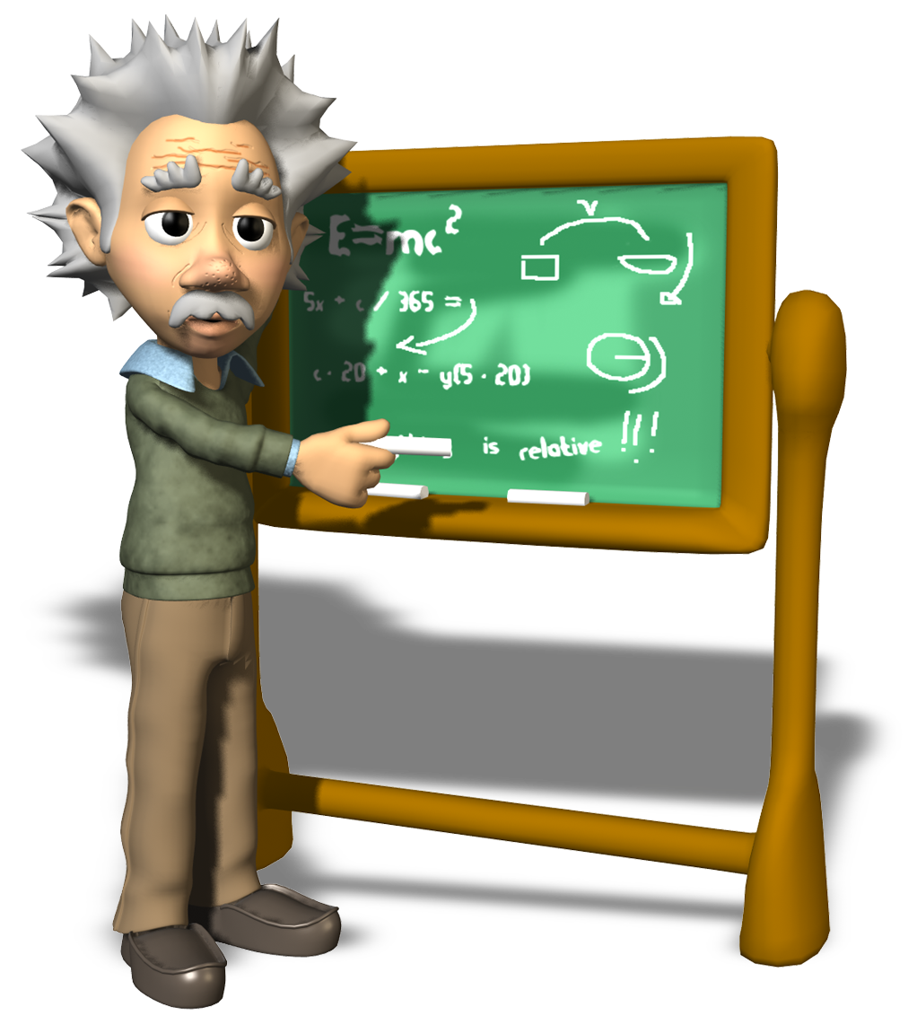
To Coach or Not to Coach?
THAT is the question… or is it?
Using Neuroscience to Maximize Learning
& Change
HCS-ODU Co-hort Class
January 13, 2015
Eric A. Stone
Title I Leadership Coach

Slide 2
Today’s Learning Intentions
By the end of our time together ….. (revised)
I (will) have a basic understanding of neuroleadership.
I (will) know when it’s most beneficial to interact with staff as a supervisor, a mentor, and a coach.
I can identify at least 2 coaching skills/components that will become part of my communication skill repertoire.
I can apply this information in my “teacher-life” and schedule a time with Eric to share my experiences.
Notes:
What are we gojng to learn today?

Slide 3
Success Criteria:
I know I am a successful learner when:
I explain, citing at least 2 reasons, when it’s appropriate to act in the role of a supervisor, a mentor, and a coach, based on my knowledge of neuroscience.
I create an experiment/opportunity for applying this information and schedule a time (face to face, email or phone call) with Eric to share the results of my experiment.
Notes:
How will I know if I’m successful as a learner? ….. As a presenter? IF you can do this!
Exit ticket? Small group circle discussion rubric?

Slide 4

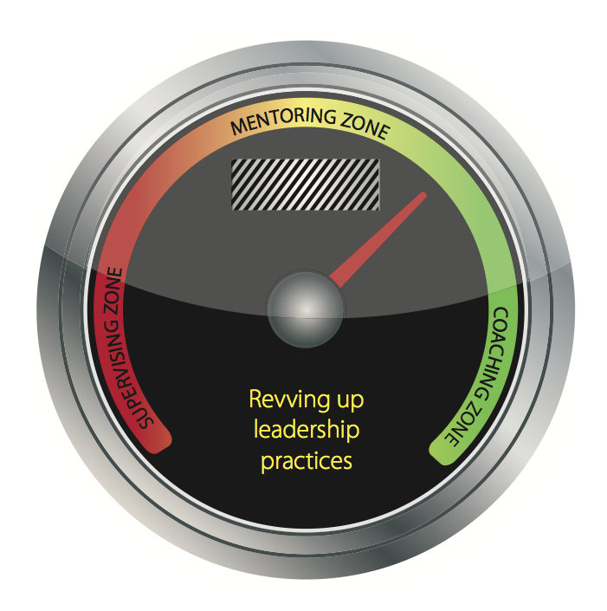
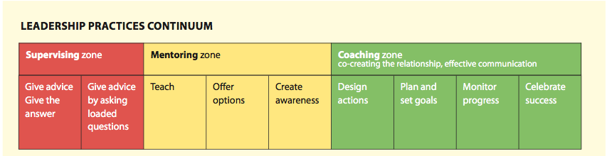
LEADERSHIP PRACTICES CONTINUUM
Notes:
We’ll also be spending time here today…. but we are gonna spend the first 30 minutes of class to get the “WHY of NeuroLeadership that will get us to this Leadership Practices Continuum.
Note that MUCH coursework and emphasis has been placed on SUPERVISION and some MENTORING over the past several decades. Today will focus on the practice of COACHING within the Leadership continuum.

Slide 5
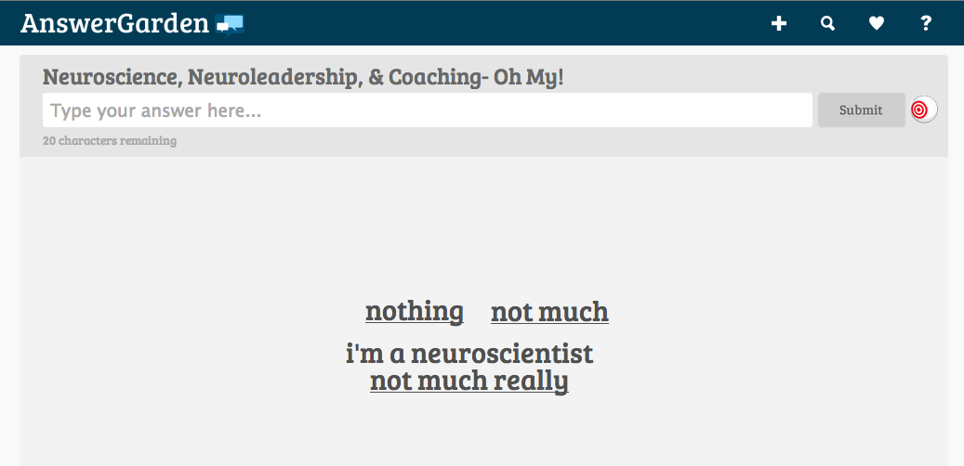
Assess your knowledge level:
Go to this link (in your email) and type a brief statement about your present knowledge of Neuroleadership:
http://answergarden.ch/view/134204
Notes:
Let’s look at the results…..

Slide 6
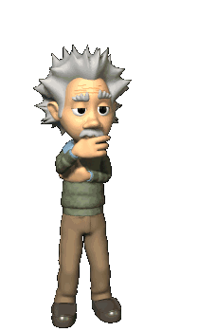
Lessons from Neuroscience
http://www.ericjensen.com/
David Rock
David Sousa
http://faculty.washington.edu/chudler/neurok.html
www.richannel.org
www.neuroleadership.com
http://www.quietleadership.com/index
Eric Jensen
www.sciencedaily.com/news/mind_brain
Brains.org
Eric Chudler
www.neuroleadership.org
Notes:
These are all MY favorite and MOST trusted websites and researchers on brain based learning. Eric Jensen, David Sousa, David Rock on iTunes Podcasts, ASCD resources, Corwin Press, Amazon, Barnes and Nobles etc.
“Were there many “physiological-type” responses in our Answer Garden?…”
Anybody mention neurons?…. Dendrites?… electrical impulses? …. corpus collossum?... Occipital lobe? ……. S?

Slide 7

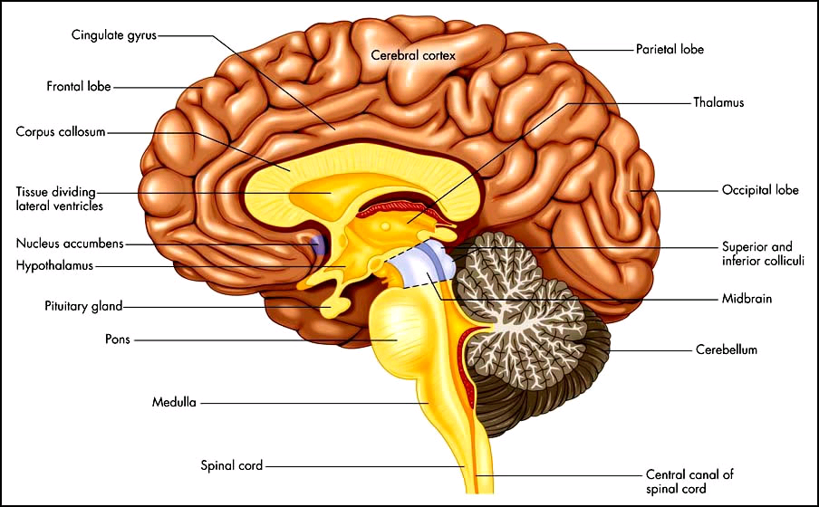
Anatomy of the Brain
Notes:
I’m not going to talk about the frontal cortex, corpus collosum, occipital lobe, brain stem, dendrites, neuron, axioms, etc…. Neat stuff and cool to say… but unfortunately overwhelms most educators and they shy away from brain research… NeurosLEADERSHIP isn’t about the ANATOMY as much as it is about the studying about the brain’s FUNCTION and its COMMON SENSE implications in providing leadership.

Slide 8
Lessons from Neuroscience
Brains have trillions of layers of connective wiring. New research indicates that “old” wiring isn’t replaced with new wiring when learning occurs. This new wiring informs our emotions and actions.
Change is difficult because we can’t change the wiring, only the thinking about that wiring…..
Notes:
The brain needs water to provide better connectivity for those electrical impulses, GOOD THING- exercise gives us oxygen to the brain by increasing blood flow…. Another GOOD THING… Sleep/rest allows the brain to “back-up the learning -via transferring memories from stm to ltm . ANOTHER GOOD THING- Kids cannot learn in a stressful environment b/c the brain is operating in “survival mode”- deciding whether to FIGHT or take FLIGHT and what might this look in a classroom??… Acting out? Withdrawing?
I could go on and on…… Let’s look at this slide and its implication on learning and leading

Slide 9
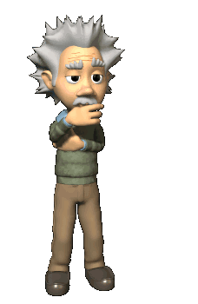
However….
The good news is the new wiring can be created with new behaviors that provides connections with new choices for thinking and behaviors.
It just takes time, repetition, and positive feedback.
Notes:
SAY "Knowing what you just read, about time, repetition, and positive fedback"…….. NEXT SLIDE

Slide 10
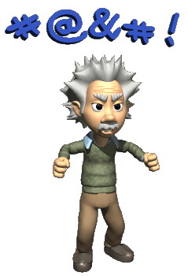
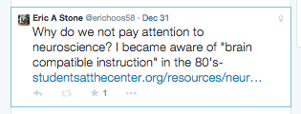
I even TWEETED about it

Slide 11
Lesson Planning
Turn to your partner and discuss how this research can guide our Executive Directors and building administrators on HCS’s continued emphasis on improving instruction through improved lesson planning.

Slide 12
Share Out
.
Notes:
How effective is our lesson planning initiative? Is it getting us where we want to be? Why or why not?
Rewiring our brains takes LOTS of time, repetition, and positive feedback.

Slide 13

Iceberg Model
If you want to improve performance,
the most effective way to do this is to
start at the bottom-
to improve thinking.
Performance/Results
Behavior
THINKING
FEELINGS
Notes:
SAY “ WHEN LEADERS WANT TO IMPROVE PERFORMANCE, THEY TEND TO STAY AT THE SURFACE LEVEL AND FOCUS OF THE BEHAVIOR ITSELF. WE MUST HAVE CONVERSATIONS ABOUT THE BEHAVIORS THAT ARE DRIVEN BY ARE THINKING AND FEELINGS. That is how we will improve results/performance!
“As a leader, you can’t make people change….. but you can help them change their thinking”

Slide 14
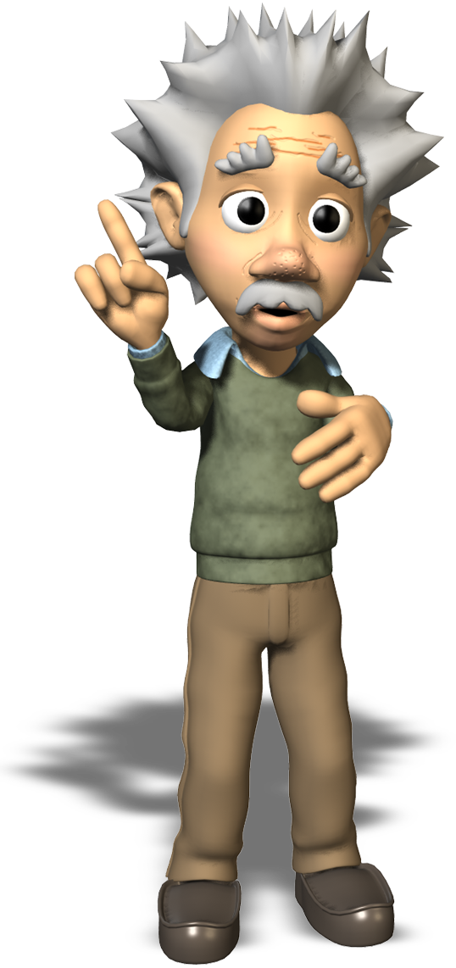
How are we doing Kyle?

Slide 15
What is Neuroleadership?
It is the neuroscience of how leaders:
Make decisions and solve problems
Regulate emotions
Collaborate with others
Facilitate change

Slide 16
What leaders need to learn
How and why change is so hard at the biological level
How to turn overwhelming threats into manageable threats
How to help others see the future
How to regulate their own & other’s emotions effectively
How to have tough conversations

Slide 17
Neuro 5
How and why change is
so hard at the
biological level

Slide 18
Neuro 5
2. How to turn overwhelming threats into manageable threats
go to 22:30-26:30
Neuroscience of Leading Change
audio

Slide 19
Brain’s Primary Organizing Principle
Away
Toward
Threat
Reward
Uncertainty
Problem focused
Avoid
Tunnel vision
Data focused
Disengaged
Interest
Solution focused
Approach
Global view
Connection focused
Engaged
From Neuroscience of Leading Change webinar NLG/NLI; 16May 2013

Slide 20
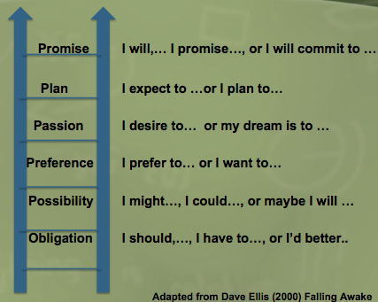
“Neuro 5”
3. How to help others see the future
Ladder of
Intentional Speech

Slide 21
Ladder of Intentional Speech Patterns
Promise I will,… I promise…, or I will commit to …
Plan I expect to …or I plan to…
Passion I desire to… or my dream is to …
Preference I prefer to… or I want to…
Possibility I might…, I could…, or maybe I will …
Obligation I should,…, I have to…, or I’d better..
Adapted from Dave Ellis (2000) Falling Awake
Notes:
Listen for staff speech patterns- when setting goals, planning , CLT conversations,

Slide 22
“Neuro 5”
4. How to regulate their own & other’s emotions effectively

Slide 23
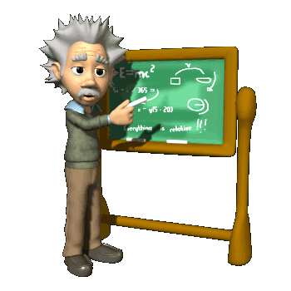

S.C.A.R.F. from David Rock’s research
PAGE ONE: SCARF
Buddy read aloud OR read silently independently
article
Notes:
Just starting to touch on this in the webinar clip earlier….

Slide 24
S.C.A.R.F. from David Rock’s research
Status-
Certainty
Autonomy
Relatedness
Fairness
One’s sense of importance/position relative to others
One’s need for clarity, ability to predict
Sense of control over own life
One’s connection to and security with another
Just and unbiased exchange between people
article
Notes:
Understand S.C.A.R.F is one way to help us regulate our own emotions and the emotions of others.

Slide 25
“Neuro 5”
5. How to have tough conversations
Committed Listening
Intentional Language

Slide 26

Powerful Conversation Tools
Committed Listening
  Pay attention to body language
  Value silence
  Listen w/o obligation to act
  Avoid unproductive patterns of listening
Intentional Language
  Asking Powerful Questions
  Presuming Positive Intent & Belief
  Reflective Feedback
Notes:
SAY “If we want to increase results and improve performance, our leadership language must be refined to increase and improve people’s thinking about their work.
Committed Listening and Intentional Language (don’t read off sub-skills…. I could do a semester course on Neuroleadership and really get into these skills in detail and allow for demos and practice activities )
“We are going to play around with some of these sub-skills so you can get an idea what the look like, sound like, and feel like!”

Slide 27
Iceberg Model
If you want to improve performance,
the most effective way to do this is to
start at the bottom-
to improve thinking.
Performance/Results
Behavior
THINKING
FEELINGS
Notes:
Going back to our HCS Lesson planning effort, is it getting us where we want to be? Why or why not?
Rewiring our brains takes LOTS of time, repetition, and positive feedback. Have we changed teachers THINKING about lesson plans? How about their FEELINGS regarding lesson plans?
Lesson Plan Templates focus on the behavior……. But have we changed their thinking/feelings about writing lesson plans???

Slide 28
Today’s Learning Intentions
By the end of our time together …..
I will have a basic understanding of neuroleadership.
I will know when it’s most beneficial to interact with staff as a supervisor, a mentor, and a coach.
I will identify at least 2 coaching skills/components that will become part of my communication skill repertoire.
I will apply this information in my “teacher-life” and schedule a time with Eric to share my experiences.
Notes:
Definitely have addressed #1 and getting in to #2!

Slide 29
Body Language and Nonverbal Cues
What are some non-verbal cues that indicate you are listening….. and being listened to?
What about cues that show someone is NOT Listening?
Notes:
GIVE FOLKS S P A C E TO THINK, BREATHE, REFLECT, AND SPEAK

Slide 30
Value Silence
W.A.I.T.
h m a NO ADVICE
y l
k
i
n
g
S.E.E.
& Stop Explaining Everything
Notes:
GIVE FOLKS S P A C E TO THINK, BREATHE, REFLECT, AND SPEAK

Slide 31

Listen without obligation to act
When others share with us, they are not automatically asking us for a response
Dorice’s story
Notes:
Dorice’s story - P. 41 Ask Kyle to read now……..

Slide 32
Today’s Learning Intentions
By the end of our time together …..
I will have a basic understanding of neuroleadership.
I will know when it’s most beneficial to interact with staff as a supervisor, a mentor, and a coach.
I will identify at least 2 coaching skills/components that will become part of my communication skill repertoire.
I will apply this information in my “teacher-life” and schedule a time with Eric to share my experiences.

Slide 33
Let’s watch this cool video about LISTENING and ASKING QUESTIONS

Slide 34
Golfing Coach Video
http://www.performanceconsultants.com/coaching-versus-instruction
Notes:
5 Minutes

Slide 35
Think about……
these questions as you watch the video:
Identify the differences in styles of the “instructor” and the “coach”
How might you compare this golf lesson to a classroom observation and a post-observation conference?
What are your take-aways as a upcoming administrator?

Slide 36
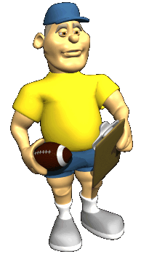
Asking Powerful Questions
Why do we ask questions as a coach?
To gain clarity
  To support generating possibilities
  To create awareness of something
  To encourage inquiry and decision making
  “Reflection precedes insight !”

Slide 37
Asking Powerful Questions
“ To tell denies or negates another’s intelligence.
To ask honors it.”
Sir John Whitmore
Notes:
PRESERVES THE RELATIONSHIP….

Slide 38
Today’s Learning Intentions
By the end of our time together …..
I will have a basic understanding of neuroleadership.
I will know when it’s most beneficial to interact with staff as a supervisor, a mentor, and a coach.
I will identify at least 2 coaching skills/components that will become part of my communication skill repertoire.
I will apply this information in my “teacher-life” and schedule a time with Eric to share my experiences.

Slide 39

Creating a Coaching Relationship
“When coaches take on the mindset of listening deeply for the needs of teachers, without judgment or intimidation, and when they show up with a mindful awareness of all that is possible in a coaching moment, coaches can generate amazing transformations (in teachers) in relatively short periods of time.”
Bob and Megan Tschannen-Moran
Evocative Coaching (2010) p.28
Notes:
As many of you are aware- HCS has entered into an agreement to offer Evocative Coaching through the Center for School Transformation during the 2004-15 school year.

Slide 40
How are we doing Kyle?

Slide 41
Today’s Learning Intentions
By the end of our time together …..
I will have a basic understanding of neuroleadership.
I will know when it’s most beneficial to interact with staff as a supervisor, a mentor, and a coach.
I will identify at least 2 coaching skills/components that will become part of my communication skill repertoire.
I will apply this information in my “teacher-life” and schedule a time with Eric to share my experiences.
Notes:
ASKING POWERFUL QUESTIONS

Slide 42
The Leadership
Continuum
Supervision
Mentor
Coaching

Slide 43
LEADERSHIP PRACTICES CONTINUUM

Slide 44
Think about….
Which principals/bosses did you ENJOY as a teacher/employee?
Which principals/bosses did you DREAD as a teacher/employee?
Identify their leadership style.
How did you react to your “favorite” leaders & why?
Notes:
Before we begin……… just think about all of the principals that you’ve worked for/with. WOW- listen to that word choice!?

Slide 45
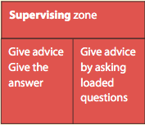
SUPERVISING
The leader gives advice, tells people what to do, solves peoples problems, or asks loaded questions like …”Well, have you thought about…?
“Leadership Practices Accelerate into High Speed”
Supervision has always been a staple in a leader’s repertoire of skills and routines. However, as the role of being a leader has evolved over time, supervising individuals is viewed as a low level action in comparison to mentoring and coaching responses.

Slide 46
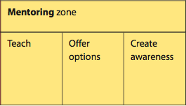
MENTORING
A mentor is an experienced role model who guides the professional development of a less experienced protégé.
*NAESP Leadership Immersion Handbook
In the field of education, mentors have been a part of the professional culture for decades. Typically, mentors are assigned to first year and novice principals in order to support and pass on their knowledge from previous experiences.

Slide 47
COACHING
“The coaching zone should be the first option leaders use when they work with others. Only after they find that a person is a novice or lacks experience should they move back to the mentoring zone. The supervisory zone should be reserved for those few staff members who challenge authority or blatantly disregard policy.”
Dori Novak, Marceta Reilly and Diana Williams, 2010.

Slide 48
Coaching Cheat Sheet

Slide 49
PROBLEM FOCUSED VS. SOLUTION FOCUSED
Why didn’t you hit your targets?
Why did this happen?
Why do you think you struggle with this?
Who’s responsible for this?
Why isn’t this working?
What do you need to do next time to hit your targets?
What do you want to achieve?
What are ways you are wanting to develop strength in this area?
Who can achieve this?
What next steps do we need to put in place to make this work?

Slide 50
Sample Questions
Can you Provide an example of a research-based strategy that you have successfully used to engage students. (P1) Prof Know
Can you Explain the planning process you use to identify appropriate resources to support instruction. (P2) Instr Planning
What strategies do you use to make your instruction relevant to students’ real lives? (P3) Instr Delivery
How do you build high-quality formative assessments? (P4) FSA
What 3 strategies do you use during transitions to increase instructional time? (P5) Learning Environment
How do you share what works in your classroom with colleagues? (P6) Professionalism
Describe the various types of assessment data you use to inform your instruction so that all students achieve. (P7) Student Academic Progress

Slide 51
Shoulder Talk
Discuss how you can use the Leadership Practices Continuum as a principal.
When is it beneficial to wear the hat of the Supervisor?
Is it fair for a building administrator to supervise teachers differently? How might this be perceived by staff?
Who benefits most from coaching?

Slide 52
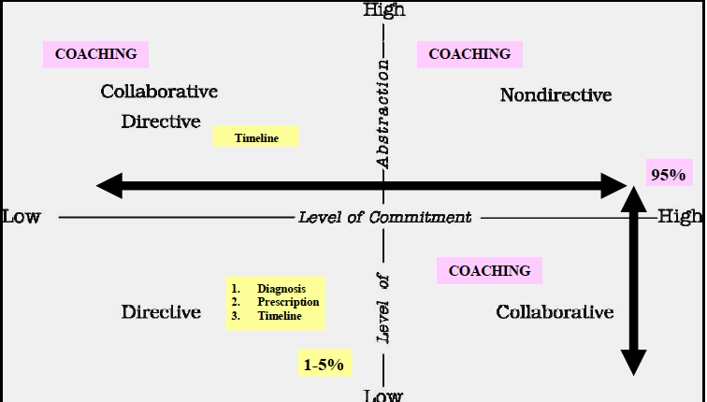
Carl Glickman’s Developmental Supervision Model

Slide 53
Today’s Learning Intentions
By the end of our time together …..
I will have a basic understanding of neuroleadership.
I will know when it’s most beneficial to interact with staff as a supervisor, a mentor, and a coach.
I will identify at least 2 coaching skills/components that will become part of my communication skill repertoire.
I will apply this information in my “teacher-life” and schedule a time with Eric to share my experiences.
Notes:
What are we gojng to learn today?

Slide 54
How are we doing Kyle?

Slide 55
Putting It Altogether…
Neuroleadership
Powerful Conversation Tools
Committed Listening
Intentional Language
Asking Powerful Questions
IF YOU BELIEVE IT,
YOU WILL SEE IT !

Slide 56
Let’s do a final check-in with our learning intentions
& success criteria

Slide 57
Today’s Learning Intentions
By the end of our time together …..
I will have a basic understanding of neuroleadership.
I will know when it’s most beneficial to interact with staff as a supervisor, a mentor, and a coach.
I will identify at least 2 coaching skills/components that will become part of my communication skill repertoire.
I will apply this information in my “teacher-life” and schedule a time with Eric to share my experiences.
Notes:
What are we gojng to learn today?

Slide 58
To Coach or Not to Coach?
THAT is the question… or is it?
“The coaching zone should be the first option leaders use when they work with others. Only after they find that a person is a novice or lacks experience should they move back to the mentoring zone.”
The supervisory zone should be reserved for those few staff members who challenge authority or blatantly disregard policy.
Notes:
It MUST our DEFAULT when serving as a leader of change! It shouldn’t evev be a question.

Slide 59
Success Criteria:
I know I am a successful learner when:
I explain, citing at least 2 reasons, when it’s appropriate to act in the role of a supervisor, a mentor, and a coach, based on my knowledge of neuroscience.
I create an experiment/opportunity for applying this information and schedule a time (face to face, email, or phone call) with Eric to share the results of my experiment.
Notes:
How will I know if I’m successful as a learner? ….. As a presenter? IF you can do this!
Exit ticket? Small group circle discussion rubric?

Slide 60
Want More????
The End
Go to
www.coachingHCS.weebly.com
for resources, including today’s presentation…..
Notes:
SIGN UP !!!!!!

Slide 61
BONUS ACTIVITY
I need a volunteer to leave the room for two minutes
Notes:
DO THIS!!!!! Ask for a volunteer to leave the room. Give the rest of the audience these instructions: When I call the volunteer back into the room, , I’m going to conduct an experiment. Arm Out- Push Down 2-3 X; then I’m going to ask the audience (THUMBS UP) to send the message you are rock strong, you are powerful- no one can push your arm down. Keep it up and straight…. Then, when I give a THUMBS DOWN, send the message “you are weak, your arms are putty, you can’t resist, give in-give in” Ready- Let’s Do it!!!

Slide 62
Is classroom climate important?
STUDENTS cannot learn/change in a stressful environment when the brain is operating in “survival mode”- deciding whether to FIGHT or take FLIGHT Classmate bullying or intimidation? Teacher bullying or intimidation?
How do students respond?
By acting out… or shutting down

Slide 63
Is school culture important ?
TEACHERS cannot learn/change in a stressful environment when the brain is operating in “survival mode”- deciding whether to FIGHT or take FLIGHT
Colleague bullying or intimidation?Administrator bullying or intimidation?
How do teachers respond?
By acting out… or shutting down

Slide 64
WTH ?????????????
Neuroscientists today are providing information to us that has the power to fundamentally rewrite the rules for
1. how we educate our children,
2. how we train our teachers, and
3. how we develop our leaders.
Why aren’t we using this research?
Notes:
WHAT THE HECK????? How many administrators and teachers follow and study neuroscience SO THAT IT HAS A DIRECT IMPACT ON LEADING AND LEARNING?

