Slide 1
Getting it Done: Leading Academic Success in Unexpected Schools
Eric A. Stone
Leadership Coach
2015 Summer Leadership Academy

Slide 2
Learning Intention
I can create a 2015-16 “Git ‘r Done” Plan using the “It’s Being Done” research

Slide 3
Success Criteria
I’ll be successful when I have written my “Git ‘r Done” Plan draft, focusing on one or more of the following:
SLP Template /PD plan
CLT agenda
Coaching Tool Box
“Rallying Cry” presentation (IBD ppt.)
???

Slide 4
Is the School Principal’s Job Doable?

Slide 5
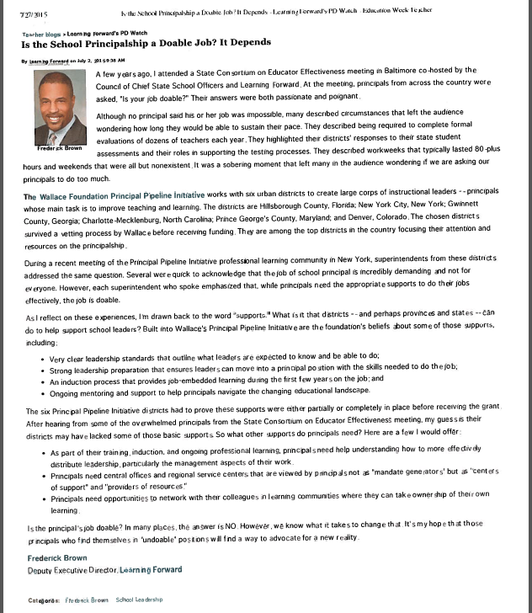
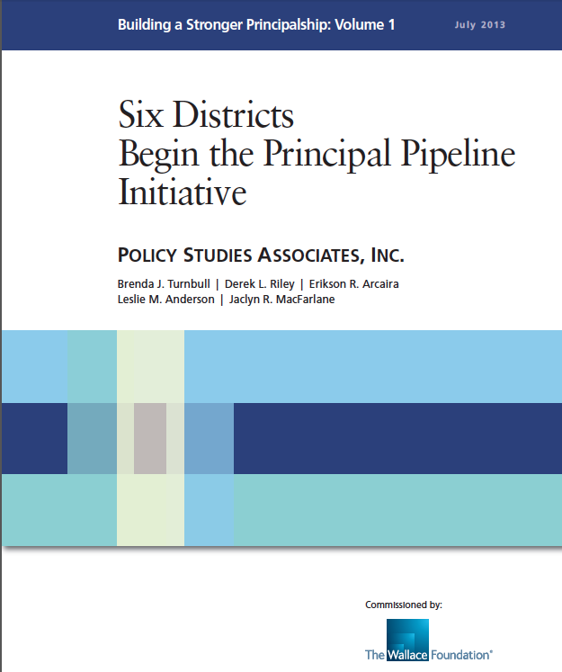
Learning Forward PD Watch
“ Is the School Principalship a Doable Job? It Depends” article
Google Drive link to folder
CoachingHCS- RESOURCES
Notes:
For your reference----- Highlights from article on NEXT slide

Slide 6
Article Highlights
Completing formal evaluations on dozens of teachers each year
District’s responses to state assessments and their roles in supporting the testing processes
80 hour work-weeks
Non-existent weekends
Wallace Foundation Principal Pipeline Initiative (84 pp.)
Principals need SUPPORT
Central Office, colleagues

Slide 7
AnswerGarden
Open email AnswerGarden link
and respond to the question:
Identify job tasks/responsibilities that you would like to see as MORE doable for 2015-16?
Notes:
BACK-UP-

Slide 8
AnswerGarden
DIRECTIONS
Individually and silently….
Make a list of job tasks & responsibilities that you would like to see as MORE doable for 2015-16?
(short answer)
2 minutes individual list
2 minute shoulder share

Slide 9
Can it be Done?
Tasks we came up with…..
Notes:
Insert responses if AnswerGarden does work on Monday!

Slide 10
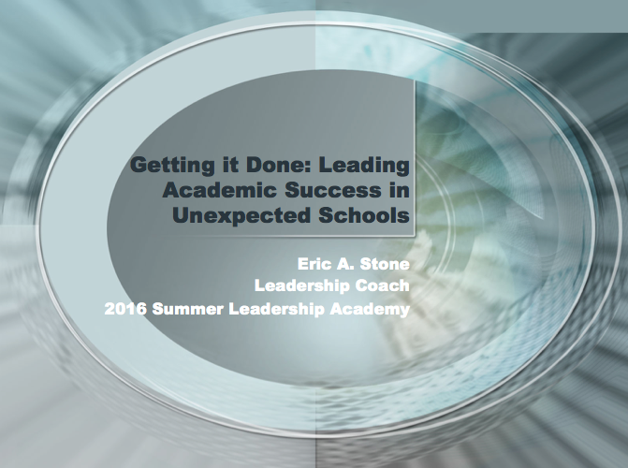
It’s Being Done!
Notes:
Switch to Education Trust powerpoint/Karin Chenoweth’s NASTID presentation

Slide 11
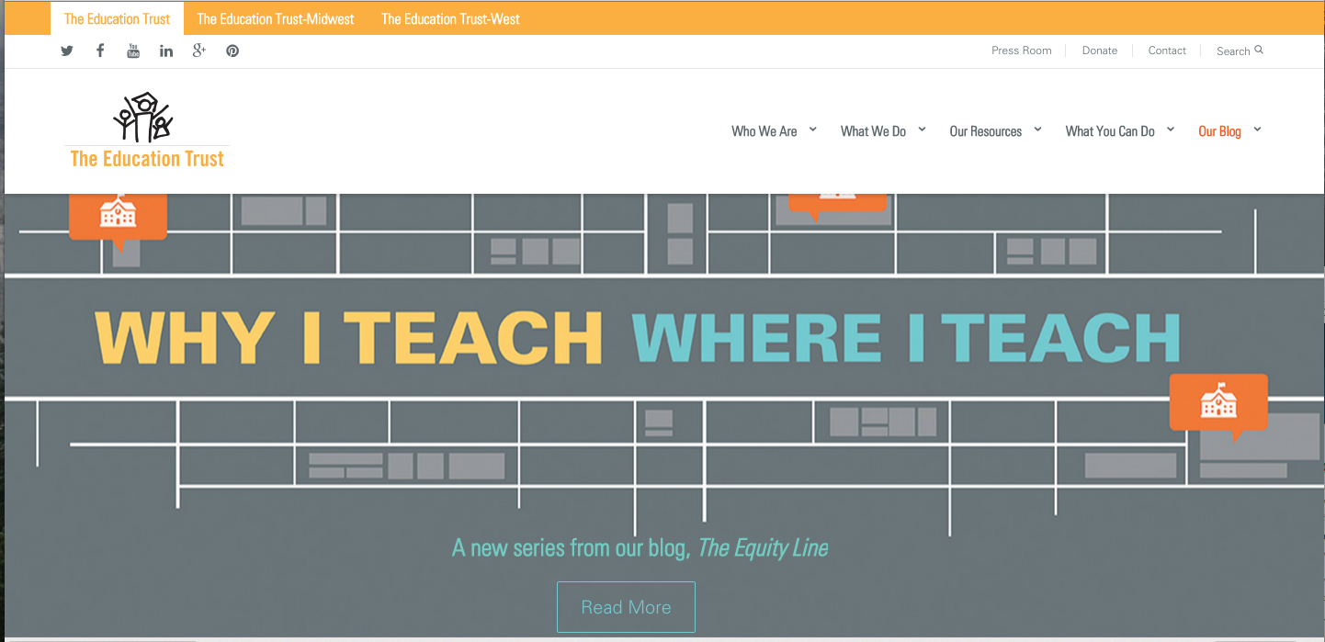
Education Trust
www.edtrust.org
The Education Trust is a national non-profit advocacy organization
that promotes high academic achievement for all students at all levels, particularly for
students of color and low income students.

Slide 12
Go to Karin Chenoweth February 2015 NASTID presentation CoachingHCS: www.coachinghcs.weebly.com Click on RESOURCES-2015 SLA-title_i_2015_national_conference.pdf

Slide 13
EXIT my PPT and go to Ed Trust/Karen Chenoweth

Slide 14
It’s Being Done 5 Common Traits
SUMMARY

Slide 15
It’s Being Done 5 Common Traits
Number One-
The common belief that
ALL STUDENTS CAN LEARN TO HIGH LEVELS
… and the common vision that
Notes:
START: “So in summary, what we learned from the Ed Trust research is that the IBD principals all have 5 common traits”…

Slide 16
It’s Being Done 5 Common Traits
… that it is up to schools to figure out how to teach all kids to high levels.
Notes:
Strategy: INSTRUCTION MUST BE EXCELLENT
Action: Teacher MUST know the difference between excellent instruction and mediocre instruction

Slide 17
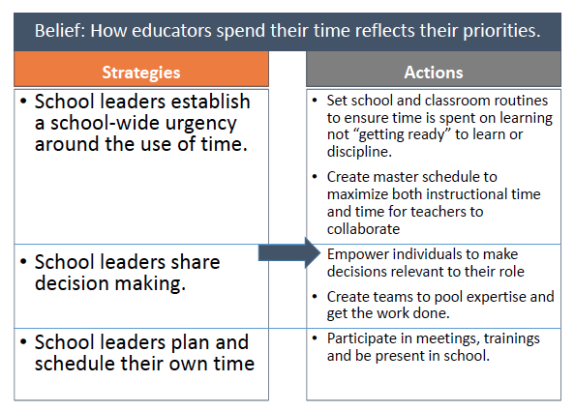
It’s Being Done 5 Common Traits
Number Two-
INSTRUCTION
is at the center of their managerial duties
Notes:
Strategy: School Leaders establish a school-wide urgency around the use of time. School Leaders share decision-making. School Leaders plan and schedule their own time
Action: School/classroom routines ensure TOT, Master schedule focus on Instr time AND collaboration, Empower individuals to make decisions, Create team of expertise, Participate in meetings, trainings, be present in school

Slide 18
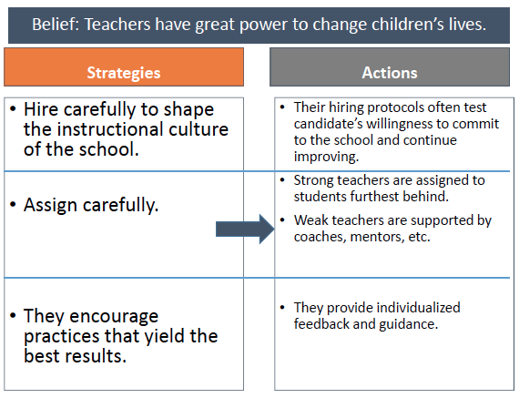
It’s Being Done 5 Common Traits
Number Three-
Focus on building the capacity of the all of the adults in the building
Notes:
Strategy: Hire carefully to shape the CULTURE, Assign teachers carefully, Encourage high yield practices,
Action: Hiring protocols test willingness to commit. Strong teachers are assigned to the students furthest behind; SUPPORT weak teachers, Provide individualized feedback

Slide 19
The Importance of COACHING WHO
Administrators
Principal
Assistant Principals
Central Office
Instructional Coaches
Mathematics
Language Arts
Special Education
(Builders of a culture of collaboration and respect)

Slide 20
The Importance of COACHING WHY
Presumes positive intent
Honors teacher’s experience and talents
Increases confidence
Increase ownership of instruction & achievement
Creates and supports culture of collaboration
(Builds trust in and capacity of staff)

Slide 21
The Importance of COACHING WHAT
Best instructional practices
Goal clarification
Action planning
Develop teaching skills
Reframe a problem into a solution
Relationship building
Evoking talents & dreams
(Identifying possibilities)

Slide 22
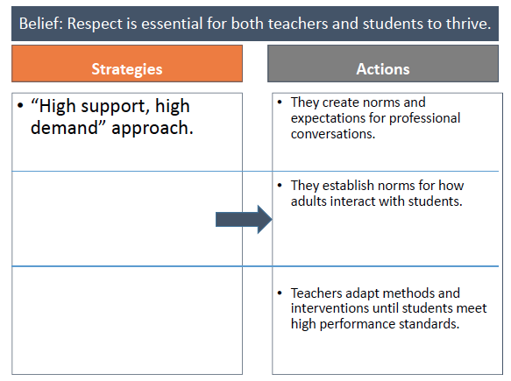
It’s Being Done 5 Common Traits
Number Four-
Deliberately create a COLLABORATIVE CULTURE
Notes:
Strategy: High support-high demand approach
Action: They create norms & expectations for professional conversations. They establish norms for how adults interact with students. Teachers adapt methods & interventions UNTIL students meet high performance standards

Slide 23
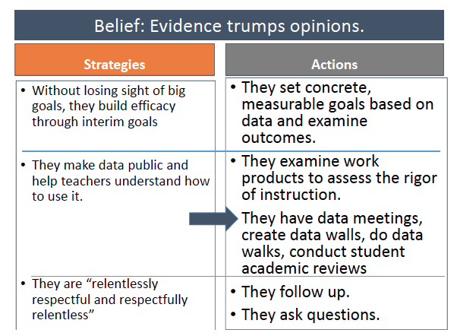
It’s Being Done 5 Common Traits
Number Five-
Monitor & evaluate what factors lead to success and what can be learned from failure
Notes:
Strategy: Big goals and little goals, Data is public and help teachers understand how to use it, “Relentlessly Respectful” AND “Respectfully Relentless”
Action: SMART Goals, SLP/PD Plan, Examine student work to assess rigor of instruction, Follow up. Ask questions

Slide 24
“Relentless Respectful and Repectfully Relentless”
Raise your hand if you are leading a school that is NOT the same school you were leading last year.
Turn and talk to your neighbor how your “newness” can work to your benefit this year?
Notes:
ASK QUESTIONS
“Tell me (more) about…. Instead of WHY? Asking why builds walls- staff get defensive

Slide 25
LEARNING INTENTION & SUCCESS CRITERIA

Slide 26
Learning Intention
I can create a 2015-16 “Git ‘r Done” Plan using the “It’s Being Done” research.
Notes:
ASK QUESTIONS
“Tell me (more) about…. Instead of WHY? Asking why builds walls- staff get defensive

Slide 27
Success Criteria EVIDENCE
“Rallying Cry” (IBD ppt.)
SLP Template PD plan
CLT agenda Coaching Tool Box
???

Slide 28
Git ‘r Done Plan Ideas/Notes
“Rallying Cry” (IBD ppt.)
SLP Template/PD plan
CLT agenda
Coaching Tool Box
What else ???

Slide 29
Git ‘r Done Plan SUPPORT
Use the GDP Request
Paper version – “complete and leave it on the table
Electronic version- link has been sent out
THANKS FOR YOUR PARTICIPATION !!
ERIC

Slide 30
elements
www.animationfactory.com

