Slide 1
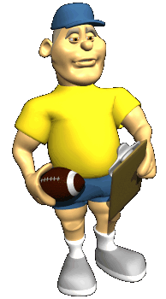
You’ve Got This- Coaching Your Staff from Good to Great
Eric Stone, Title I Leadership Coach
HCS Summer Leadership Academy
August , 2014
8:30-10:00a
Notes:
PREPARATION
Play music “Centerfield”
Select a volunteer to PRE-READ (Dorice’s story - P. 41 BOOK) to read aloud later ……..
Select 4 participants f to read from Unproductive Patterns of Listening

Slide 2
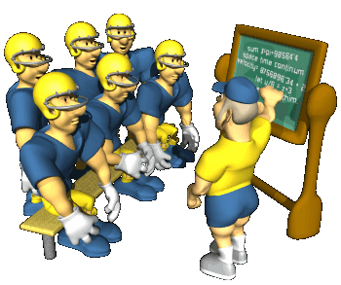
Session Description:
“This session will provide participants with both research and practical knowledge about how the brain responds while being coached and why this changes everything administrators know about supervision. Find out how to empower your staff to reach their full potential and love coming to work again!”
Presenter: Eric Stone, Title I Leadership Coach
Notes:
AS the PRESENTER, don’t you ask yourself this question?????? What’s my ‘competition”?? C’MON ADMIT IT--- What hooked participants to select my presentation over the 5 others? Content? There’s something you want to learn (more) about? Presenter?- “I know Eric, I’ve attended his presentations before”… “I have a positive RELATIONSHIP with Eric” BOTH?!- NEITHER… am I the last resort…. You’ve seen everything else and I am what’s standing between you and the end of 3 days of intense learning? !

Slide 3
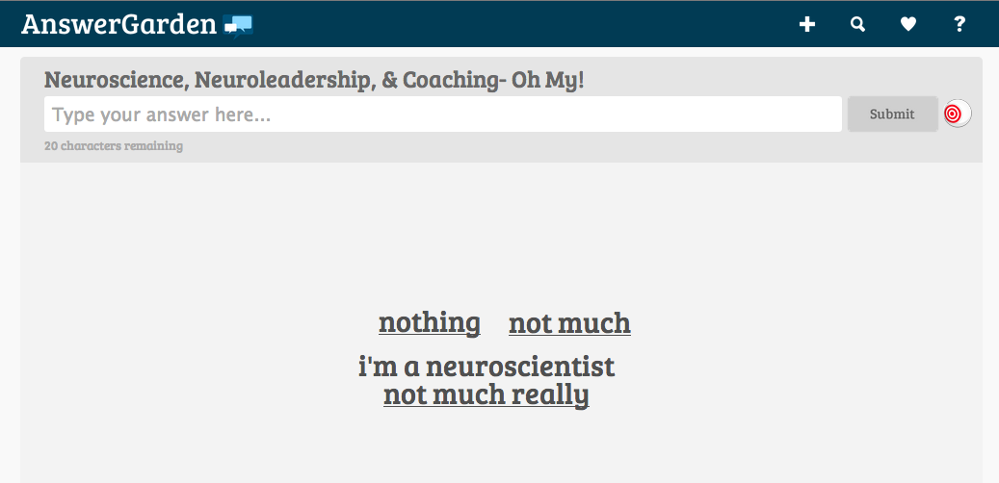
Assess your knowledge level:
Go to this link ( in your email) and type a brief statement about your present knowledge of Neuroleadership:
http://answergarden.ch/view/101180
Notes:
Let’s look at the results…..

Slide 4
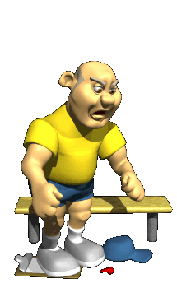
Today’s Learning Intentions
By the end of our time together this morning…..
I will have a basic understanding of neuroleadership, including S.C.A.R.F. & how our brain works in social situations.
I will identify at least 1 skill that will become part of my coaching repertoire.
I will create a personal timeline for applying this information & sharing it with my staff.
Notes:
What are we gojng to learn today?
IF WE CLEAR OUR MIND OF OTHER ISSUES, CONCERNS, ETC. - ie stay focused on the “lesson” and ACTIVELY PARTICIPATE- “” What does this look like?”
PHONES OFF- LAPTOPS CLOSED-EYES UP FRONT- ON TASK SIDE COMMENTS- HEADS NODDING-ASKING QUESTIONS
Everybody read aloud “ TODAY’S LEARNING INTENTIONS. BY THE END OF OUR TIME TOGETHER THIS MORNING…. SHARING IT WITH MY STAFF.
*** If needed- hold up You Can’t Fire Everyone and say the way we HAVE been supervising, providing feedback, conducting observations, holding employee/teacher performance conferences HASN’T yielded the kind of change in performance?!?!?!?! David Rock says-” If you want to change someone’s performance, you have to change their thinking.”
Let’s get started!!!-

Slide 5
You’ve Got This!
“Eyeball” a partner across the room.
When the music starts, go stand by your partner.
Decide who will be “W”onderful and who will be “M”arvelous.
sp
Notes:
READ SLIDE: 1. Look across the room and make eye contact with a partner. 2. When I begin to play music, physically “pair up” and then decide who will be W and M.

Slide 6
You’ve Got This!
4. W=Tell a story when you felt totally supported by an individual in your life. Who told you “You’ve Got This!
M= Listen ONLY- do not provide any verbal or non-v feedback. You cannot nod, smile, “uh-huh”, etc.
QUESTIONS? W’s: tell your story in 4 min.
BEGIN
sp
Notes:
READ SLIDE:

Slide 7
You’ve Got This! -con’t.
6. Switch roles this time so “Marvelous” tells the story when s/he truly felt “championed” by someone.
“Wonderful” will listen carefully, and may provide non-verbal feedback only. sp
M’s: tell your story in 4 minutes.
BEGIN
Notes:
Follow directions on slide- go about 5 mins. for EACH story. THEN, after W & M share, go to next slide..

Slide 8
You’ve Got This! -con’t.
After both have shared and listened, discuss your experience using the following prompts…
sp/sg4
Notes:
Circulate the room and notice BIMRS, expressions, energy, etc.

Slide 9
You’ve Got This Debrief
Discuss the following after each partner has shared:
How did it feel to tell your story?
Were you totally committed to listening to your partner?
Score your “listening performance” as 1=poor ::: 3= good ::: 5= excellent
How did it feel to be speak without receiving any feedback – v or non-v?
Check your energy level-is it different?
When your group is finished, return to your table
tt/so
Notes:
Give folks a few minutes to share at their table and then ask for volunteers to share out TABLE TALK- SHARE OUT
BRING OUT: It feels GOOD to be *listened to Without interruption* It is HARD to *Listen W/O Interruption* When we experience *”Committed Listening”*, the brain is in a “reward” state.

Slide 10
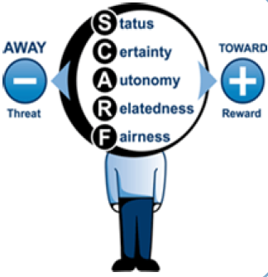
5 Domains of Experiences in the Brain
These experiences activate strong threats and rewards in the brain, thus influencing a wide range of human behaviors.
A leader’s goal is to influence by minimizing danger and maximizing reward.
Notes:
There were several purposes of Activity 1: Get you UP and Talk 2. Practice/experience “Committed Listening” 3. Build (up) some relationships and trust among the pairs and foursomes 4 To provide you with an experience you can all hook the next topic on…. S.C.A.R.F !!!

Slide 11
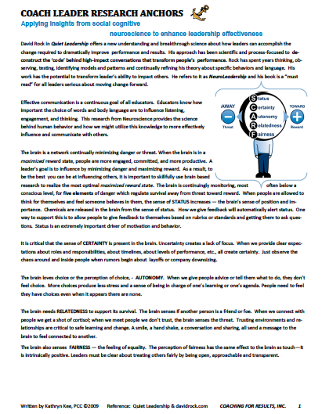
Let’s learn about S.C.A.R.F.
Partner Activity
1. All read page 1
of the article silently.
2. Discuss reactions
briefly. Then read the
top half of page 2.
Notes:
POST S C A R F Posters around the room

Slide 12
Let’s learn more about S.C.A.R.F.
David Rock Video & Gallery Walk
Watch and listen to David Rock explain the S.C.A.R.F. model
As you listen, jot down examples on sticky notes when a staff member may experience “threat” and/or “reward” during the day. Think about real life situations that occur with teachers, principals, parents, supervisors, etc.
Following the video, we will participate in a Gallery Walk
http://youtu.be/isiSOeMVJQk
Notes:
http://youtu.be/isiSOeMVJQk hyperlink in ppt. ; EXPLAIN the GW process before playing the video
“Letter off” S C A R F sticky/write and share out with group. NO Rotation

Slide 13
STATUS
S

Slide 14
CERTAINTY
C
Notes:
Brain wants to KNOW what is happening, what is going to Happen

Slide 15
AUTONOMY
A

Slide 16
RELATEDNESS
R

Slide 17
FAIRNESS
F

Slide 18
Why SCARF?
The SCARF model improves people’s capacity to understand and ultimately modify their own and other’s behavior in social situations.
BEFORE: Prediction
SCARF can help us predict whether a threat is going to happen & modify our activities or choices accordingly
Notes:
In this case, if the principal knows there is going to be a restructuring of the grade level team, ( Hmmm, this could be threatening their STATUS) Therefore, he could offset this sense of threat by increasing the teacher’s sense of certainty about the situation by providing more information and increasing their sense of autonomy by providing some choice in how the process occurs.

Slide 19
Why SCARF?
DURING: Regulation
SCARF helps us notice “in real time” a (perceived) threat is occurring so we can identify the cause of the threat response through labeling. Labeling the response (in SCARF terminology) allows us to re-appraise the situation ands reduce the threat/increase engagement.
If we can self-regulate our emotions by monitoring experiences via SCARF, we can make better choices and reduce social conflict.
Notes:
In this case, let’s say during a CLT a teacher started crying or screaming at what seems like “no apparent reason”, Labeling her threat response as she felt her effort was being attacked by others in the meeting ,i.e. STATUS decrease, would allow the team to access the situation through SELF-REGULATION- which consists of both labeling and reappraising. Doing this in the heat of the moment, where possible, can help people make better choices & reduce social conflict.

Slide 20
Why SCARF?
AFTER: Explanatory
After an emotional event, SCARF can help people explain and therefore understand a situation.
Using SCARF to explain a situation after the event may be the easiest and the most likely use of SCARF. However, with sufficient awareness and training of the model, people will move to using it before and during an event.
GOAL: From explanatory to regulatory to predictive

Slide 21
The Social Brain
“Leaders who understand this dynamic (the link between social connection and physical discomfort within the brain) can more effectively engage their employees’ best talents, support collaborative teams, and create an environment that fosters productive change.”
“The ability to intentionally address the social brain in the service of optimal performance will be distinguishing leadership capability in the years ahead.”
David Rock article
“Managing With the Brain in Mind” *
Notes:
This is cool stuff----- is this brain research for REAL? Absolutely….. NEXT SLIDE

Slide 22
What is Neuroleadership?
It is the neuroscience of how leaders:
Make decisions and solve problems
Regulate emotions
Collaborate with others
Facilitate change
Notes:
Think about how does this apply to my situation… informs what IS working & explains what is NOT working. Today’s presentation cannot begin to address all of these facets but will provide an introduction. The field is HUGE!!!!

Slide 23
Neuroleadership
Notes:
We have touched on bits and pieces throughout the presentation. Resources will be available on my CoachingHCS website, including this link to a webinar “Using Neuroscience to Lead Change” AWESOME STUFF!! This is a screen shot from a webinar I’ll provide the link for at the end of this presentation.

Slide 24
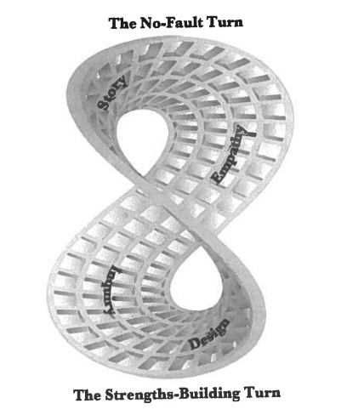
Leaders That Coach Staff
Leaders who believe deeply in the potential of others and have witnessed transformation within themselves or others are what is needed in the 21st Century
Learning about coaching
used in coaching and
implementing them within
the Evocative Coaching
model is the year-long
professional development
focus for HCS Administrators
during 2014-15.
Notes:
We have touched on bits and pieces throughout the presentation. Resources will be available on my CoachingHCS website.
CAUTION: David Rock/business & management VS. Evocative Coaching/Coaching for Results
Use SCARF to Influence behavior Understand SCARF to create relationship/environment
“Manipulative”? Evocative

Slide 25
Creating a Coaching Relationship
“When coaches take on the mindset of listening deeply for the needs of teachers, without judgment or intimidation, and when they show up with a mindful awareness of all that is possible in a coaching moment, coaches can generate amazing transformations (in teachers) in relatively short periods of time.”
Bob and Megan Tschannen-Moran
Evocative Coaching (2010) p.28
Notes:
As many of you are aware- HCS has entered into an agreement to offer Evocative Coaching through the Center for School Transformation during the 2004-15 school year. Almost half of our administrators have already participated in the EC Summer Institute last month and we’ll pick up the remainder next Monday and Tuesday August 11-12.

Slide 26
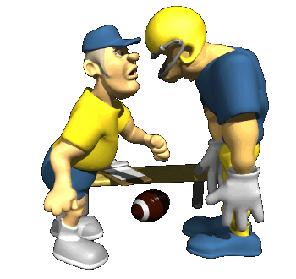
Powerful Conversation Tools
Committed Listening
Pay attention to body language
Value silence
Listen w/o obligation to act
Avoid unproductive patterns of listening
Intentional Language
Asking Powerful Questions
Presuming Positive Intent & Belief
Reflective Feedback
Notes:
If we want to increase results and improve performance, our leadership language must be refined to increase and improve people’s thinking about their work.
2 I want to focus on two skills today- Committed Listening and Intentional Language ( don’t read off sub-skills)
GO BACK TO SCARF posters for examples…

Slide 27
Committed Listening
Pay attention to verbal & non-v communication
Listen without obligation to act
CL
Value Silence
Avoid unproductive patterns of listening
Notes:
We experienced Committed Listening earlier this morning, remember? CL involves these behaviors. What are others that have worked for you? How about based on SCARF?- what can you do to INCREASE ENGAGEMENT and DECREASE THREAT? Remove barriers (desk)…. Close laptop…. Lean in… etc.

Slide 28
Body Language and Nonverbal Cues
Notes:
GIVE FOLKS S P A C E TO THINK, BREATHE, REFLECT, AND SPEAK

Slide 29
Value Silence
W.A.I.T.
h m a NO ADVICE
y l
k
i
n
g
S.E.E.
& Stop Explaining Everything
Notes:
GIVE FOLKS S P A C E TO THINK, BREATHE, REFLECT, AND SPEAK

Slide 30
Listen without obligation to act
When others share with us, they are not automatically asking us for a response
Dorice’s story
Notes:
Dorice’s story - P. 41 Ask for a volunteer to read now……..

Slide 31
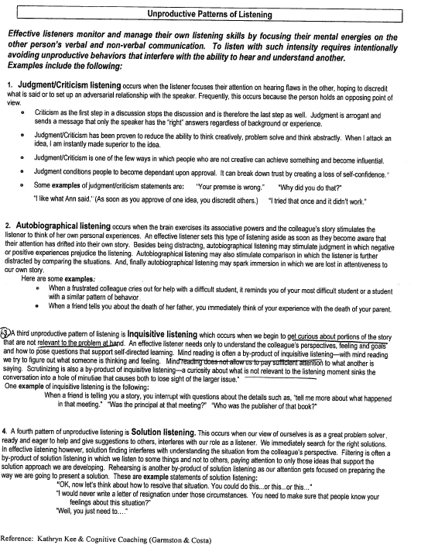
Unproductive Patterns of Listening
Judgment /Criticism Listening
Autobiographical Listening
Inquisitive Listening
Solution Listening
sp
Notes:
Refer to handout- go to coachinghcs.weebly.com
Volunteer to share with me about their favorite session at the SLA from Monday/Tuesday- I will model
1. Patterns of Unproductive Listening
Unproductive Patterns of Listening

Slide 32
Committed Listening
LISTEN FOR …
What the person wants
Emotion
Passion
Possibility / Potential
Reframe:
Negative > Positive
Problem > Solution
Complaint > Commitment

Slide 33
Asking Powerful Questions
Why do we ask questions as a coach?
To gain clarity
To support generating possibilities
To create awareness of something
To encourage inquiry and decision making
“Reflection precedes insight !”

Slide 34
Asking Powerful Questions
“ To tell denies or negates another’s intelligence.
To ask honors it.”
Sir John Whitmore
Notes:
PRESERVES THE RELATIONSHIP….

Slide 35
Intentional Language
If we want to increase results and improve performance, our leadership language must be refined to increase and improve people’s thinking about their work.
“The first question is fateful.”
The RIGHT question stimulates thinking and builds bridges
The WRONG question stops communication and builds walls.

Slide 36
Ladder of Intentional Speech Patterns
Promise I will,… I promise…, or I will commit to …
Plan I expect to …or I plan to…
Passion I desire to… or my dream is to …
Preference I prefer to… or I want to…
Possibility I might…, I could…, or maybe I will …
Obligation I should,…, I have to…, or I’d better..
Adapted from Dave Ellis (2000) Falling Awake
Notes:
Listen for staff speech patterns- when setting goals, planning , CLT conversations,

Slide 37
Powerful Coaching Conversations
Pre-observation or goal setting conference

Slide 38
Powerful Coaching Conversations
Post-observation conference
SETTING THE STAGE
Office or classroom
Side by side or across the table/desk
Timing

Slide 39
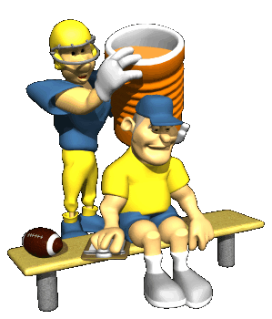
Powerful Coaching Conversations
Post-observation conference
QUESTIONS
Can you Provide an example of a research-based strategy that you have successfully used to engage students. (P1) Prof Know
Can you Explain the planning process you use to identify appropriate resources to support instruction. (P2) Instr Planning
What strategies do you use to make your instruction relevant to students’ real lives? (P3) Instr Delivery

Slide 40
Powerful Coaching Conversations
Post-observation conference
QUESTIONS
How do you build high-quality formative assessments? (P4) FSA
What 3 strategies do you use during transitions to increase instructional time? (P5) Learning Environment
How do you share what works in your classroom with colleagues? (P6) Professionalism
Describe the various types of assessment data you use to inform your instruction so that all students achieve. (P7) Student Academic Progress
Notes:
Add examples from my Title I site

Slide 41
Creating a Coaching Relationship
“Evocative Coaches get results more quickly than directive coaches precisely because of how we connect with teachers using a calm, compatible, and confident energy that generates engagement, willingness, cooperation, openness, and excitement.”
Bob and Megan Tschannen-Moran
Evocative Coaching (2010) p.33

Slide 42
Today’s Learning Intentions
By the end of our time together this morning…..
I will have a basic understanding of neuroleadership, including S.C.A.R.F. & how our brain works in social situations.
I will identify at least 1 skill that will become part of my coaching repertoire.
I will create a personal timeline for applying this information & sharing it with my staff.
Go to Putting It Altogether…
Notes:
GO TO NEXT SLIDE….

Slide 43
Putting It Altogether…
Neuroleadership
S.C.A.R.F.
Powerful Conversation Tools
Committed Listening
Intentional Language
Asking Powerful Questions
IF YOU BELIEVE IT,
YOU WILL SEE IT !

Slide 44
Want More????
Evocative Coaching
Summer Institute-II
NEXT WEEK
August 11-12
Hunter B. Andrews PK-8
8:00-3:30
To request link: estone@hampton.k12.va.us
Notes:
SIGN UP !!!!!!

Slide 45
The End
Go to
www.coachingHCS.weebly.com
for resources, including today’s presentation

Slide 46
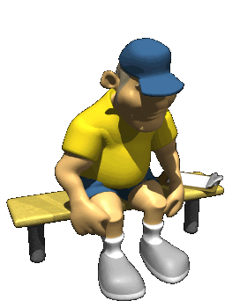
Elements
www.animationfactory.com

