Slide 1
The Strengths-BuilDing Turn: Celebrating Strengths to Foster Teacher Self-Efficacy
Megan Tschannen-Moran

Slide 2
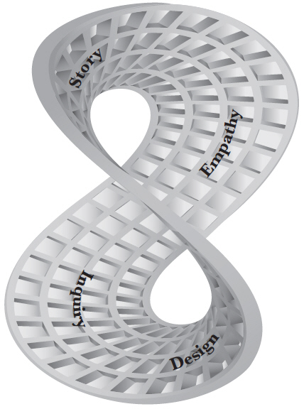
Evocative Coaching Model
No-Fault Turn
Story Listening
Expressing Empathy
Strengths-Building Turn
Appreciative Inquiry
Design Thinking

Slide 3
How did you Grow?
Creative Energy Check-in
How did you grow in your use of your Evocative Coaching / Instructional Leadership skills?

Slide 4
Strengths-Based Focus
Notes:
Instead of focusing on weaknesses and threats, there is evidence to suggest that our planning will be more creative, actionable, and robust when we focus on our strengths.
Marcus Buckingham cautions us that:
“Excellence is not the opposite of failure. To learn about success you have to study success. Only successful examples can tell you what excellence looks like.”

Slide 5
Teacher Self-Efficacy
A judgment of one’s capabilities to bring about student engagement and learning, even among those students who may be difficult or unmotivated
Notes:
Self-efficacy beliefs are the beliefs people hold about their capability to be successful in any given endeavor.
Four decades of research on teachers’ self-efficacy beliefs have confirmed that these beliefs have a strong impact on motivation, on the goals people set, their persistence in the face of obstacles and their resilience in the face of setbacks.
These beliefs also function at the collective, as the cultural beliefs among an entire faculty reflect either a sense of capability or incapacity.

Slide 6
Sources of Self-Efficacy
Physiological Arousal
Vicarious Experience
Verbal Persuasion
Mastery Experience
Notes:
Albert Bandura, the architect of social cognitive theory, said,
“It is far easier to discourage someone with our words than to encourage them.”
Unfortunately, we do an awful lot of that in schools.

Slide 7
Teacher Sense of Efficacy Model
Sources of Efficacy Information
Physiological Arousal
Vicarious Experience
Verbal Persuasion
Mastery Experience
New Sources of Efficacy Information
Analysis of Teaching Task
Assessment of Personal Teaching Competence
Cognitive Processing
Teacher Sense of Efficacy
Consequences of Teacher Efficacy
Goals, Effort, Persistence, Etc.
Performance

Slide 8
Consequences of Teacher Self-Efficacy
Greater effort invested in teaching
Set higher goals
Greater levels of planning
Greater organization
More willing to experiment with new methods
Greater enthusiasm in teaching
Greater commitment to stay in teaching

Slide 9
Teacher Relations with Struggling Students
Persistence
Less critical of students when they make errors
Work longer with a student who is struggling
Less inclined to refer a struggling student to special education
Resilience

Slide 10
Student Outcomes
students’ motivation
students’ self- efficacy
student achievement

Slide 11
Implications
Teacher preparation would focus more on mastery experiences
Supervisors would adopt a strengths-based approach
Novice teachers would be protected and supported in their first years in the classroom

Slide 12
Search for the Holy Grail
Notes:
For over five decades, educational researchers have been on a quest to identify variables more powerful than SES in explaining student achievement.
I’m here to tell you that at long last, we have found the holy grail of educational research!

Slide 13
Academic Optimism
Trust
Collective Efficacy / Student Identification
Academic Press

Slide 14
Faculty Trust in Administrators
Student Achievement
Faculty Trust in Administrators
Notes:
R = .43 (p <.01)

Slide 15
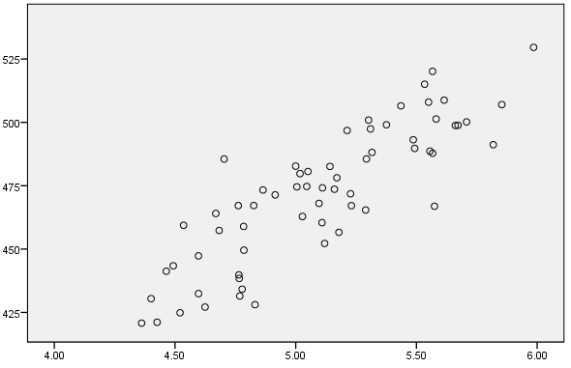
Faculty Academic Optimism
Student Achievement
Faculty Academic Optimism
Notes:
R = .86 (p <.01)

Slide 16
Watching Successful

Slide 17
Positive Self-Monitoring

Slide 18
Videre
http://leadlearner.org/apps

Slide 19
The Principles of Appreciation
Positive Actions & Outcomes
Positive Energy & Emotion
Positive Conversations & Interactions
Positive Questions & Reflections
Positive Anticipation of the Future
Positive Attention in the Present
Notes:
Positive Principle: Positive Energy and Emotion
Constructionist Principle: Positive Conversations and Interactions
Simultaneity Principle: Positive Question and Reflections
Anticipatory Principle: Positive anticipation of the future
Poetic Principle: Positive attention in the present

Slide 20
SWOT
Notes:
We’re all too familiar with the traditional SWOT analysis. FWAP!
When we get together to make plans to address the challenges we face, we’ve been taught to explore our collective Strengths, Weaknesses, Opportunities and Threats. But what gets all of the attention? All the energy immediately gets sucked up by the Weaknesses and the Threats and those become the focus.
We identify gaps between our aspirations and our current realities, and we go looking for the root cause of those gaps. But all too often in the search for causes, we end up identifying culprits. And as soon as the finger pointing starts, self-protection and deflecting blame become the name of the game.
One organizational consultant claimed that if we really looked at the research on the SWOT analysis, that it would be due for a product recall!
Some of where this Yes, But mentality comes from is our faith in the importance of doing a SWOT analysis – you know, looking at our Strengths, Weaknesses, Opportunities and Threats. But let’s be honest, as soon as we lay this all out on the table, all of the energy and attention gets honed in on the weaknesses and threats.

Slide 21
SOAR
Strengths
Opportunities
Aspirations
and
Resources

Slide 22
Teacher Aggression
Yelling
Sarcasm
Humiliation
Group punishment for individual misdemeanors

Slide 23
Observation Tools
Downloadable in Resources Section
www.SchoolTransformation.com

Slide 24
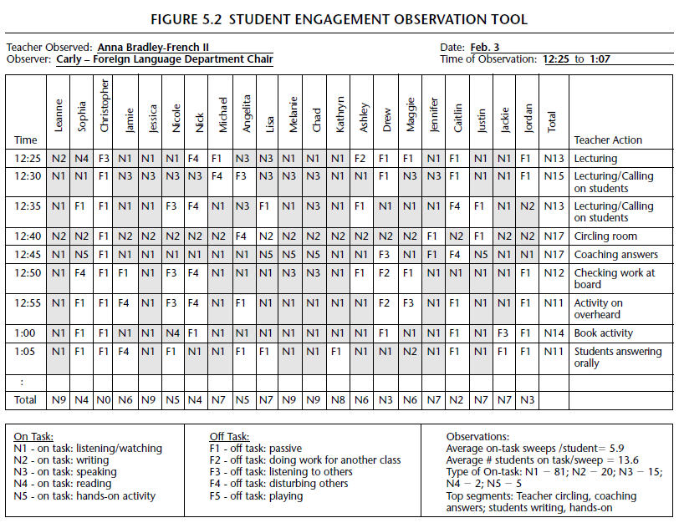
Student Engagement Observation Tool

Slide 25
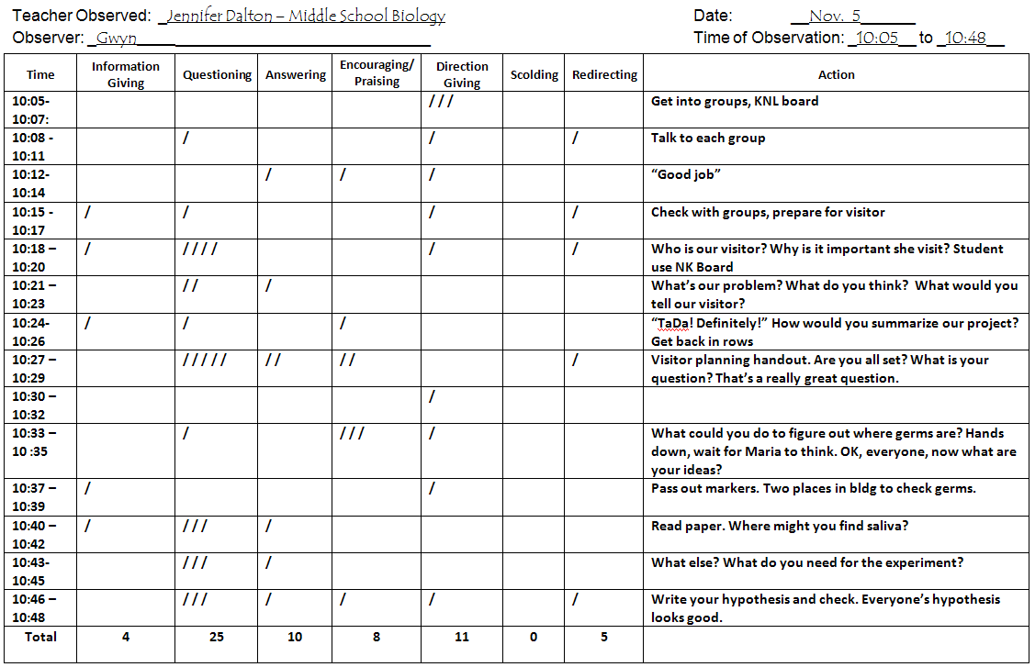
Teacher Verbal Behaviors Observation Tool

Slide 26
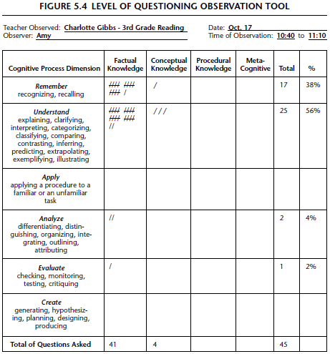
Level of Questioning Observation Tool

Slide 27
For More Information Contact:
megan@schooltransformation.com

